Slide 1
Search 2

Slide 2
Avoiding Repeated States

Slide 3

Repeated States
Loopy path - includes the path from Arad to Sibiu and back to Arad again
Repeated state - We say that ln(Arad) is a repeated state in the search tree, generated in this case by a Ioopy path.
loopy paths means that the complete search tree for Romania is infinite
  there is no limit on how often one can traverse a loop.
On the other hand, the state space- (the Romania map) has only 20 states

Slide 4
Repeated States
A loopy path is never better. Why ?
Loops can cause certain algorithms to fail, making otherwise solvable problems unsolvable.
Ex: DFS
path costs are additive and step costs are nonnegative
So a loopy path to any given state is never better than the same path with the loop removed.

Slide 5
State Space vs. Search tree
Ex: Route finding problem
State space – n states for n cities
Search tree – there are infinite number of paths in this state space (a good search algorithm is expected to avoid repeated paths)
So, there are infinite number of nodes

Slide 6
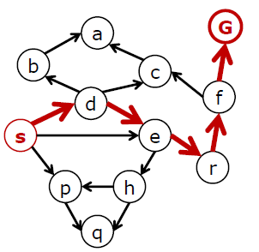
State space Graph

Slide 7
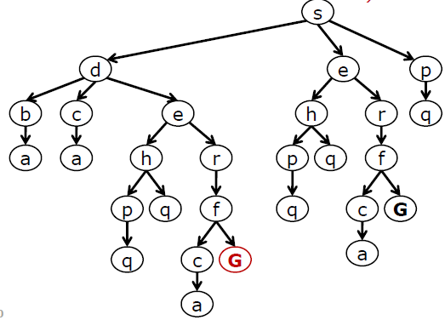
State space tree
Each NODE in the search tree is an entire PATH in the state graph (note how many nodes in the graph appear multiple times in the search tree)

Slide 8
Nodes vs. States
Node: a book-keeping data structure to represent the search tree
State: a configuration of the domain
Nodes are on certain paths but states are not
Two different nodes can contain the same state, if that state is generated via two different paths

Slide 9
Redundant Paths
Loopy paths are a special case of the more general concept of redundant paths
redundant paths exist whenever there is more than one way to get from one state to another.
Consider the paths Arad-Sibiu (140 km long) and Arad-Zerind-Oradea-Sibiu (297 km long).
Obviously, the second path is redundant- a worse way to get to the same state.
It is not required to keep more than one path to any given state
  because any goal state that is reachable by extending one path is also reachable by extending the other.

Slide 10
Redundant Paths
In some cases, it is possible to define the problem itself so as to eliminate redundant paths.
Example: 8-queens problem Formulation
if we reformulate the problem so that each new queen is placed in the leftmost empty column, then each state can be reached only through one path (1).
If a queen can be placed in any column, then each state with n queens can be reached by n! different paths (2)

Slide 11
Formulation of 8-queen problem -1
Ex: The formulation of 8-queen problem
  Each new queen is placed in the leftmost empty column
Each state can be reached only through one path
So, efficient formulation

Slide 12
Formulation of 8-queen problem
Formulation: add a queen to any square in the leftmost empty column
Q |  |  |  |  |  | Q
 |  |  |  | Q
 | Q
 |  | Q |  |  | Q
 |  |  | Q
 |  |  |  |  |  |  | Q

Slide 13
Formulation of 8-queen problem -2
Ex: The formulation of 8-queen problem
  A queen can be placed in any column
Each state with n queens can be reached by n! different paths

Slide 14
Formulation of 8-queen problem -2
Formulation: add a queen to any column
Q
 | Q |  |  | Q
Q
 |  |  |  |  | Q
 |  | Q
 |  |  |  |  | Q
 |  |  | Q

Slide 15
Avoiding Repeated States
2)For some problems, repeated states are unavoidable
Ex: route-finding problems and sliding blocks puzzles
  where the actions are reversible
The search trees are infinite
Repeated states have to be pruned to make the finite tree size

Slide 16
Avoiding Repeated States
3) It is possible to eliminate repeated states by considering search tree up to a fixed depth d
A state space of d+1 states becomes a tree with 2^{d} leaves

Slide 17
Avoiding Repeated States
So, repeated states has to be detected by the algorithm.
Detection : Compare the node to be expanded with nodes that are expanded already
If a match is found, then the algorithm has discovered two paths to the same state and can discard one of them

Slide 18
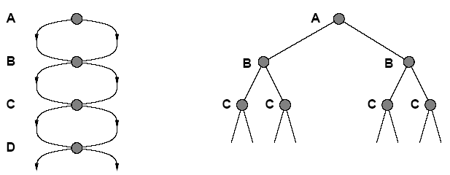
Avoiding Repeated States
Failure to detect repeated states can turn a solvable problem into unsolvable ones as explained below.
State Space
Fig. 1
Search Tree
A state space (Fig. 1) in which there are two possible actions from each state
The state space contains 4 (or d +1) states where 3 (or d) is the max. depth
However, search tree has 2^{d} branches corresponding to these paths

Slide 19
Avoiding Repeated States
Depth-first strategy:
1. How to ensure finite state spaces do not turn into infinite search tree?
The nodes in memory are those on the path from the root to the current node
Comparing those nodes to the current node allows the algorithm to detect looping paths that can be discarded immediately
Avoids looping paths
But, there is still exponential proliferation of non looping paths shown in Fig. 1

Slide 20
Avoiding Repeated States
How to avoid exponential proliferation of non looping paths (Fig. 1)?
    Keep track of all nodes expanded so far
    If an algorithm remembers every state that it has visited, then the algorithm can be exploring the state space graph directly
    Requires modifying the general tree search algorithm to include a data structure called explored set (closed list)
So, there is a trade off between space and time
Algorithms that forget their history are doomed to repeat it
Trade off between the cost of extra search and the cost of checking for repeated states.

Slide 21
The General Graph search algorithm
frontier (Open list) - which stores every unexpanded node
explored set (Closed list) stores every expanded node
If the current node matches a node on closed list, it is discarded instead of being expanded

Slide 22
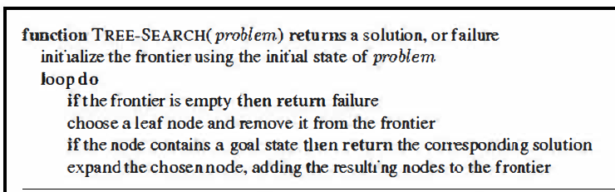
Informal Description of search tree Algorithm

Slide 23
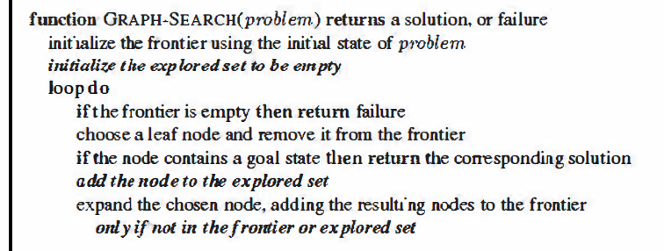
General Graph search algorithm

Slide 24
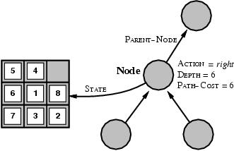
Node data structure
A state is a (representation of) a physical configuration
A node is a data structure belong to a search tree
  Here node= <state, parent-node, action, path-cost, depth>

Slide 25
Node representation
A node can be represented in many ways
A node can be represented as a data structure with 4 components
  STATE: the state in the state space to which the node corresponds
  PARENT: the node in the search tree that generated this node
  ACTION: the action that was applied to the parent to generate the node
  PATH-COST: the cost of the path from the initial state to the node as indicated by the parent pointers, denoted g(n)

Slide 26
Infrastructure for search algorithms
Search algorithms require a data structure to keep track of the search tree that is being constructed.
For each node n of the tree, we have a structure that contains four components:
  n.STATE: the state in the state space to which the node corresponds;
  n.PARENT: the node in the search tree that generated this node;
  n.ACTION: the action that was applied to the parent to generate the node;
  n.PATH-COST: the cost, traditionally denoted by g(n), of the path from the initial state to the node, as indicated by the parent pointers

Slide 27
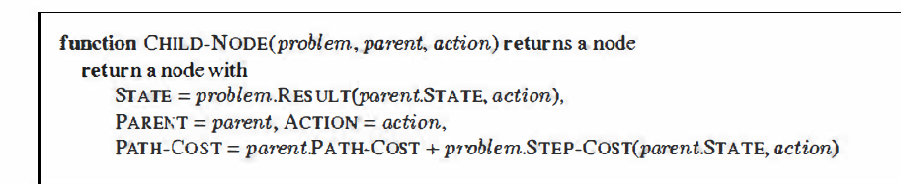
How to compute the components of a child node?
Given the components for a parent node, it is easy to see how to compute the necessary components for a child node.
The function CHILD-NODE takes a parent node and an action and returns the resulting child node

Slide 28
General Tree search algorithm – formal description
Queue operations
EMPTY?(queue) return true only if queue is empty
POP(queue) removes the first element of the queue and returns it
INSERT(element, queue) inserts an element into the queue and returns the resulting queue

Slide 29
Measuring Problem Solving performance
The output of a problem solving algorithm is either failure or a solution
Four ways of evaluating algorithm’s performance
  Completeness
    does it always find a solution if one exists?
  Time complexity
    How long it takes to find a solution?
    number of nodes generated during the search
  Space complexity
    How much memory is needed to perform the search?
    maximum number of nodes stored in memory
  Optimality
    does it always find a least-cost solution?

Slide 30
Time and space complexity
State space graph is viewed as an explicit data structure which is input to the search program
Typical measure is the size of the state space graph
In AI, graph is represented implicitly by the initial state, actions and transition model and is frequently infinite
So, complexity is expressed in terms of:
  b: branching factor
    depends on possible actions
    max number of successors of any node
  d: depth of the shallowest goal node
  m: maximum length of any path in the state space

Slide 31
Time and Space Complexity: Illustration
A goal node is found on depth d of the tree
d
m
b
G

Slide 32
Measuring Effectiveness of a search algorithm
Two ways
1) Search cost
  Depends on the time complexity and memory usage
2) Total cost
  By combining the search cost and solution cost which is the path cost of the solution found
Ex: route finding problem
  Search cost is the amount of time taken by the search
  Solution cost is the total length of the path (in km)
Total cost = search cost (in millisecs)+ solution cost (in kms)
There is no standard way for conversion
But, conversion from kms to msecs can be done by using an estimate of the car’s average speed

Slide 33
Search Strategies
Search Strategy: are distinguished by the order in which nodes are expanded
1)Uninformed search strategies (blind search):
uses only the information available in the problem definition
no additional information beyond states and successors
All they can do is to generate successors and distinguish a goal state from a non goal state
2) Informed search or heuristic search strategies:
Strategies that know whether one non goal state is “more promising” than another
expands “more promising” states

Slide 34
Uninformed Search Strategies
Breadth-First Search
Uniform-Cost Search
Depth-First Search
Depth-Limited Search
Iterative Deepening Depth-First Search
Bidirectional search

Slide 35
Breadth-First Search
Recall from Data Structures the basic algorithm for a breadth-first search on a graph or tree
Expand the shallowest unexpanded node
Place all new successors at the end of a FIFO queue

Slide 36
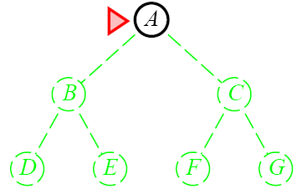
Breadth-First Search for a binary tree
Marker – is shown for the node to be expanded next

Slide 37
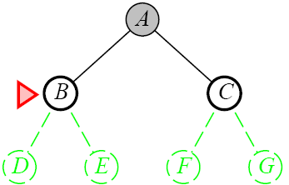
Breadth-First Search

Slide 38
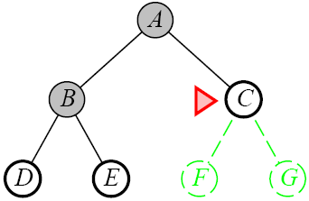
Breadth-First Search

Slide 39
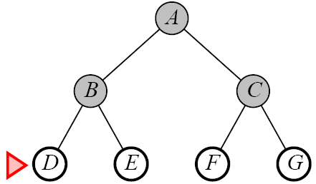
Breadth-First Search

Slide 40
Breadth-first search
S
Move downwards, level by level, until goal is reached.
A
D
B
D
A
E
C
E
E
B
B
F
D
F
B
F
C
E
A
C
G
G
C
G
F
G

Slide 41
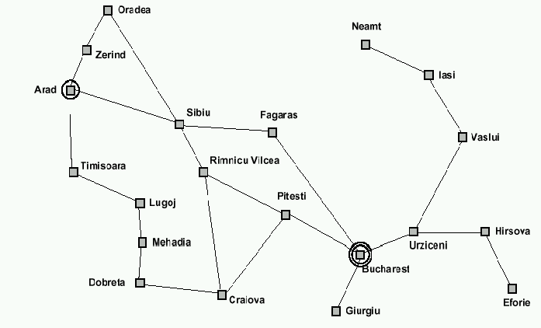
Breadth-first search: Traveling from Arad To Bucharest

Slide 42
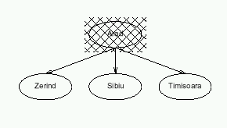
Breadth-first search
CSE-610, Dept. of CS&E.

Slide 43
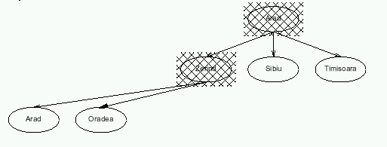
Breadth-first search
CSE-610, Dept. of CS&E.

Slide 44
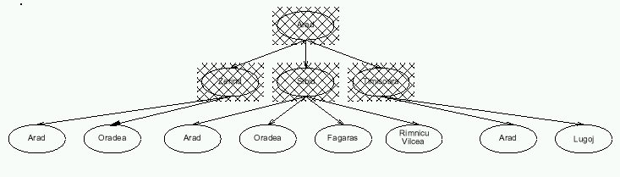
Breadth-first search

Slide 45
Informal Description of search tree Algorithm

Slide 46
General Graph search algorithm

Slide 47
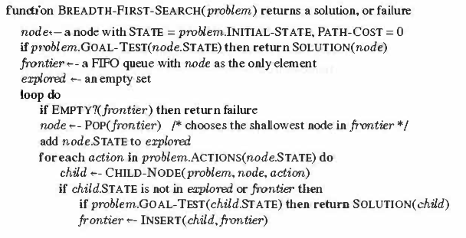
BFS Algorithm
Note: add node to the explored set before expanding

Slide 48
How to compute the components of a child node?
Given the components for a parent node, it is easy to see how to compute the necessary components for a child node.
The function CHILD-NODE takes a parent node and an action and returns the resulting child node

Slide 49
Breadth-first search: evaluation
Completeness:
  Does it always find a solution if one exists?
  YES
    If shallowest goal node is at some finite depth d
    Condition: If b is finite
      (maximum num. of succ. nodes is finite)

Slide 50
Time Complexity
When is the goal test applied on the general graph-search algorithm ?
The goal test is applied to each node when it is generated rather than when it is selected for expansion.

Slide 51
Breadth-first search: evaluation
When is the goal test applied on the general graph-search algorithm ?
The goal test is applied to each node when it is generated rather than when it is selected for expansion.
Time complexity:
  Assume a state space where every state has b successors.
    root has b successors, each node at the next level has again b successors (total b²), …
    Assume solution is at depth d
    In the worst case, assume goal node is the last node generated at that level.
    Total numb. of nodes generated:
    1 + b + b² + … + b^{d} = O(b^{d})

Slide 52
Breadth-first search: evaluation
Time complexity:
  Assume a state space where every state has b successors.
    If the algorithm were to apply the goal test to nodes when selected for expansion, rather than when generated then what is the time complexity ?
    The whole layer of nodes at depth d would be expanded before the goal was detected
    So the time complexity would be O(b^{d+1})
    It means expand all but the last node at depth d (goal is not expanded)
    1 + b + b² + … + b^{d} + b(b^{d}-1) = O(b^{d+1})

Slide 53
Breadth-first search: evaluation
Space complexity:
Every node is part of frontier (every generated node has to be stored in memory)
There will be O(b^{d-1}) nodes in the explored set and O(b^{d}) nodes in the frontier,
so the space complexity is O(b^{d}), i.e., it is dominated by the size of the frontier.

Slide 54
Breadth-first search: evaluation
Optimality:
  Does it always find the least-cost solution?
  Following the general template for graph search, discards any new path to a state already in the frontier or explored set;
  it is easy to see that any such path must be at least as deep as the one already found.
  Thus, breadth-first search always has the shallowest path to every node on the frontier.
  In general YES
    unless actions have different cost.

Slide 55
Exponential Growth
The time and memory required for a breadth first search
Assume branching factor b = 10
1 million nodes can be generated per second
A node requires 1000 bytes of storage.
Find out time and memory requirements for various values of depth

Slide 56
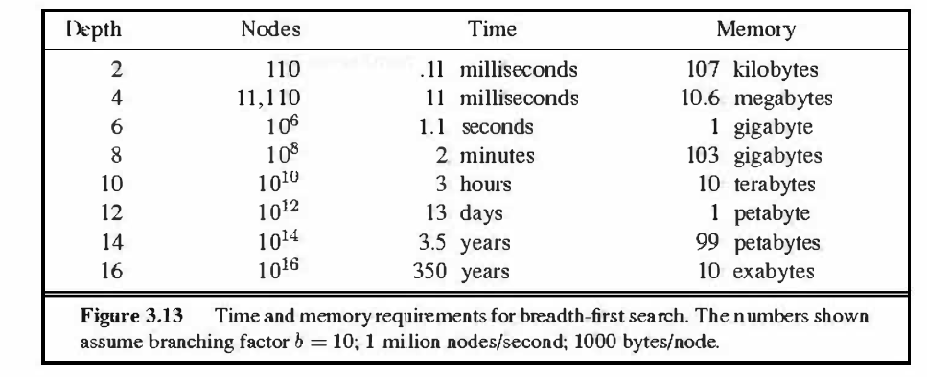
Exponential Growth for BFS
1000 Bytes = 1 Kilobyte
· 1000 Kilobytes = 1 Megabyte
· 1000 Megabytes = 1 Gigabyte
· 1000 Gigabytes = 1 Terabyte
· 1000 Terabytes = 1 Petabyte
· 1000 Petabytes = 1 Exabyte

Slide 57
Exponential Growth: Observations
Space is more of a factor to breadth first search than time
It is meaningless if we need to wait 13 days for an answer to a level 12 problem. But no personal computer has petabyte of memory
Time is still an issue. It could be argued that as technology gets faster then exponential growth will not be a problem. But even if technology is faster we would still have to wait 350 years for a level 16 problem and what if we hit a level 17 problem!
Exponential-complexity search problems cannot be solved by uninformed methods for any but the smallest instances
Exponential growth quickly makes complete state space searches unrealistic

Slide 58
Lessons From Breadth First Search
The memory requirements are a bigger problem for breadth-first search than is execution time
Exponential-complexity search problems cannot be solved by uniformed methods for any but the smallest instances

Slide 59


